Slide 1

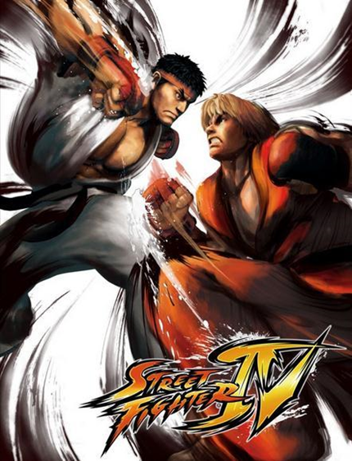

Project: Street Fighter 2
reporter:Zhao Zirui
Wu Yiwen
Yu Zijun
time：2025.07.17

Slide 2




CONTENTS
01
02
03
Introduction
Core Features
Development
04
05&06
07
AI design
Getting Start
&Control
Conclusion

Slide 3


01
Introduction

Slide 4


Welcome
Opening Remarks
Welcome everyone to the presentation of "Project: Street Fighter," a game inspired by classic arcade 2D fighting titles. This project aims to bring back the excitement and intensity of head-to-head battles.

Slide 5

Game Overview
Core Concept
"Street Fighter" is a fast-paced, head-to-head 2D fighting game. Players must use skill, reflexes, and strategy to deplete their opponent's 100 HP and achieve a K.O.

Slide 6
02
Core Features

Slide 7




Balanced System
01
The game features a balanced combat system where moves have priority. For example, anti-air attacks beat aerial moves, ensuring a fair and strategic battle.
Dynamic Combat
Extensive Moveset
02
Players have access to a wide range of moves, including punches, kicks, crouch attacks, jump kicks, and wave boxes, providing deep gameplay.
Game Modes
03
"Street Fighter" offers two exciting game modes: Player vs. AI and Player vs. Player, catering to both solo and multiplayer experiences.

Slide 8



Audio Experience
Authentic Sound
The game includes immersive background music and impactful sound effects to enhance the arcade experience, making every match feel intense.

Slide 9
03
Development

Slide 10



Engine Modules
Core Module
Audio Functions
The game was built using the `arcade_2d` module from Source Academy. Key functions include `create_sprite` for visuals, `gameobjects_overlap` for hit detection, and `input_key_down` for controls.
Audio functions like `create_audio` and `play_audio` were used to create a dynamic soundscape, adding to the game's immersive quality.

Slide 11
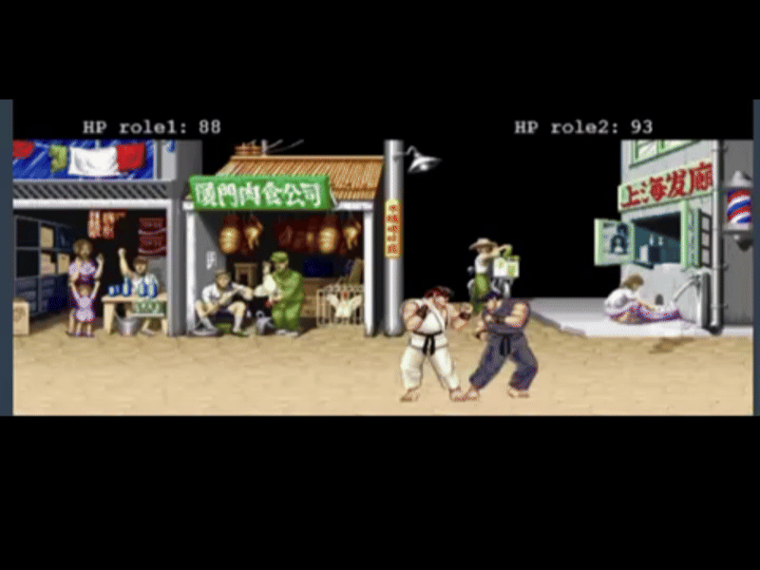

Creative Process
01
02
03
Animation
Combat Logic
Replayability
Frame-by-frame animations were used to create smooth character movements. Each frame is displayed with a specific duration, ensuring realistic actions.
The game offers high replayability with dual game modes and an intelligent AI, ensuring that players stay engaged and challenged.
A scientific combat logic was implemented, where moves counter each other. For example, kicks interrupt punches, and crouching dodges kicks, adding depth to the gameplay.

Slide 12
04
AI Design

Slide 13


Collaboration
Human-AI Partnership
The AI opponent was developed through a unique human-AI collaboration. The AI assistant provided complex code, resulting in a multi-layered and competitive AI.

Slide 14
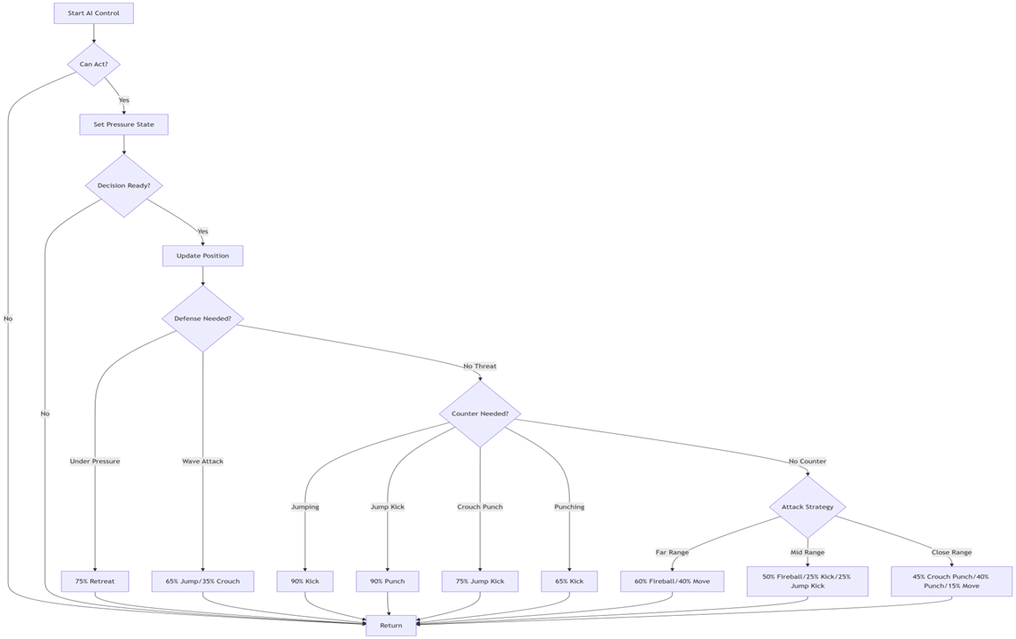
Logic Flow
Decision Hierarchy
The AI uses a hierarchical decision-making process. It prioritizes survival, reacts to player actions, and executes proactive tactics based on distance, making it a formidable opponent.

Slide 15
05
Getting Started

Slide 16
Launch Process
Initial Steps
To start, load the game and wait for the welcome screen. Choose your mode by pressing '1' for AI or '2' for PVP. Press 'B' to begin the match.

Slide 17

06
Controls

Slide 18
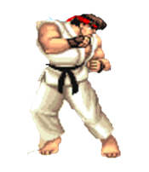
Player 1 Controls
Movement
Attacks
Player 1 uses WASD for movement: W for jump, A/D for walking, and S for crouch. This setup ensures intuitive control for quick reflexes.
Player 1 has access to punch (1), kick (2), and wave boxing (3). Combo moves like S + 1 for crouch punch and W + 2 for jump kick add variety.

Slide 19
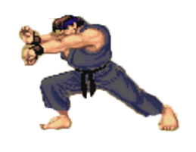

Player 2 Controls
Attacks
01
Player 2's attacks are mapped to J (punch), U (kick), and I (wave boxing). Combo moves include Arrow Down + J for crouch punch and Arrow Up + U for jump kick.
Movement
02
Player 2 uses the arrow keys for movement: Arrow Up for jump, Arrow Left/Right for walking, and Arrow Down for crouch, providing a familiar control scheme.

Slide 20


Upcoming Updates
New Content
Future updates will include new characters with unique special moves, more advanced AI routines, and an expanding arena, ensuring the game continues to evolve.

Slide 21
07
Conclusion

Slide 22


Closing Remarks
Final Thoughts
Thank you. "Street Fighter" is a passion project that brings the thrill of arcade fighting to life.
Prepare for battle!

Slide 23

Thank you.
reporter:Zhao Zirui
Wu Yiwen
Yu Zijun
time：2025.07.17

